Slide 1




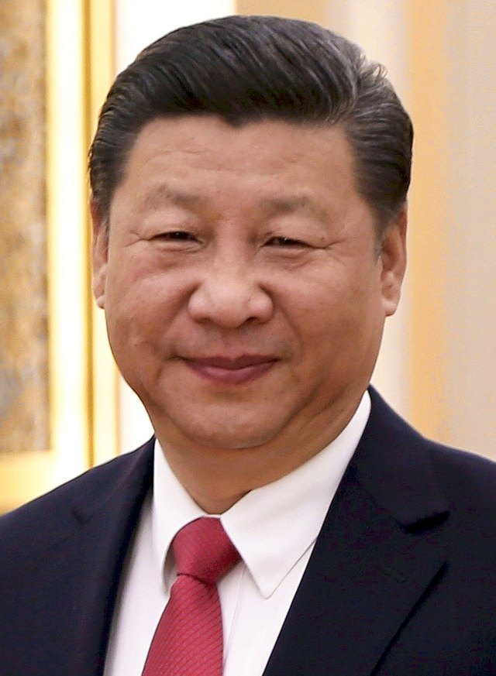

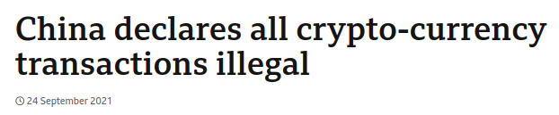
Blockchain
I do not approve :(

Slide 2

Why?
Decentralized - not owned by a specific company/entity
Distributed - located on many computers/nodes
Permissionless - anyone can run their own node
Public - anyone can view actions on the blockchain
Permanent - blocks cannot be removed from the blockchain
I have no idea what this has to do with crypto
Notes:
- Decentralized - Not owned by a specific company/entity. If this is not desired then blockchain is not necessary
- Distributed - Located on many computers/nodes
- Permissionless - anyone can run their own node
- Public - anyone can view actions of the blockchain
- Permanent - blocks cannot be removed from the blockchain. The only way to "remove" a block is to _fork_ the blockchain and hope that everyone moves over to the new one.

Slide 3
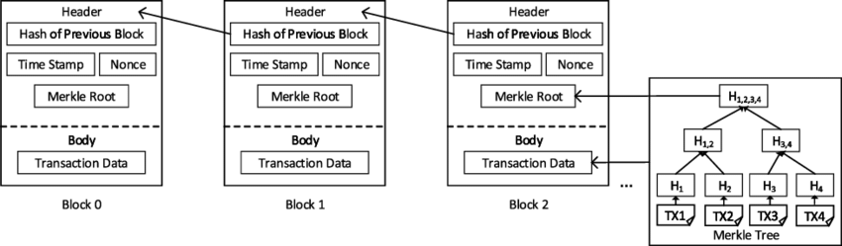
Blocks
The distributed database is made of a series of blocks
Blocks can be appended only
Each contain a hash of the previous
  Previous blocks in the chain can’t be edited
*The Merkle root is just a fancy hash of the block contents in a tree structure
https://www.shiksha.com/online-courses/articles/structure-of-a-block-in-blockchain/

Slide 4
Consensus mechanisms
Determine which new blocks are added to the blockchain
Very strict rules on which blocks are confirmed
Aim to maximize the number of people competing to mine a block, thus making attacks more difficult
  Successful miner receives a set financial reward, plus transaction fees
Chance of mining a block is stochastic
Might involve setting aside currency (proof of stake, e.g. Ethereum) or using a large amount of computing power (proof of work, e.g. Bitcoin)

Slide 5

Bitcoin
All other systems of payment except cash payments require some kind of third party (banks, credit cards, PayPal, etc.). Bitcoin aims to get around this.
Distributed ledger
Divisible to 10⁻⁸ ₿
Each block contains many transactions
New block approximately every 10 minutes
Pseudonymous - Bitcoins are transferred to addresses
  Addresses are created from a public key
  Spending bitcoin requires signing the transaction using the private key
Uses a proof-of-work consensus mechanism

Slide 6
Bitcoin’s consensus mechanism
The block reward started at 50 Bitcoin in 2009, and gets cut in half roughly every 4 years. Miners also receive transaction fees from the transactions contained in the block.
A miner collects transactions
Adds a special transaction which awards the block reward to themself
Computes the Merkel root of the transactions in the new block
Needs to find a nonce value such that SHA256(Merkel root, nonce) is less than the target hash value
The target hash value is adjusted such that the average time to mine a block remains at 10 minutes
If the target hash value is lower, the difficulty of mining a block is higher

Slide 7
Why does Proof of Work work?
It prevents transactions from being censored
  The transaction fees system incentivizes the miner to collect as many transactions as possible
  Since the chance of mining a block is stochastic dependent on the amount of computing power invested, you would have to acquire the majority of computing power to have a chance at getting a censored block confirmed
It prevents double spending
  Sometimes you can have competing blocks submitted to the chain.
  This creates a fork.
  The longest chain is considered the legitimate one.
  Theoretically, a user could submit a transaction in exchange for resources, then mine 2 competing blocks to create an alternative chain. Again, this would require the majority of computing power.

Slide 8
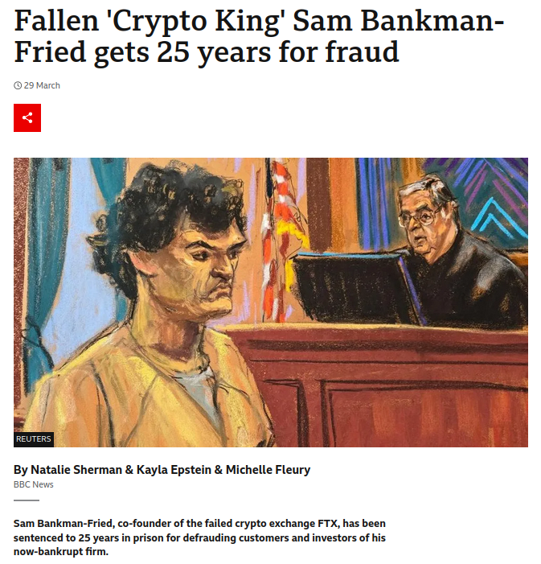
Problems with Bitcoin
It is obscenely power-intensive
  Bitcoin’s proof-of-work system used an estimated 0.2% to 0.9% of global demand for electricity in 2023
It is slow
  New blocks are added every 10 minutes
  For large transactions it is common to wait for several blocks to be confirmed
It has become more centralized
  Managing public and private keys can be a hassle, so it’s common to use web wallets/centralized cryptocurrency exchanges
  Centralized mining has made Bitcoin more vulnerable to 51% attacks…
(https://www.eia.gov/todayinenergy/detail.php?id=61364)

Slide 9
“51%” attacks
If someone gains control over the majority of the hashrate they could theoretically double-spend coins or censor transactions
This has actually happened due to the emergent behaviour of pooling:
  Since it is very unlikely to successfully mine a Bitcoin, it is common to pool mining power
  If any member in the pool mines a block, the reward is divided between all members
Ghash.io reached a 51% network hashrate in 2014 before voluntarily capping its power at 39.99%
Proof-of-stake blockchains are also vulnerable to this attack
  An attack would require staking more than half of the total currency staked

Slide 10
Blockchain summary
Blockchains rely heavily on financial incentives to maintain a trustless system
It works best when there are a large amount of users (as attacks become more difficult)

Slide 11
Messaging apps
Need to consider what level of trust be built into our system
How can we prevent old messages being inserted?
How important is having everyone seeing messages in the same order?
Probably need to run on an existing blockchain, e.g. Ethereum
  A tutorial to do just that (partially written by AI because of course) https://medium.com/coinmonks/building-a-blockchain-based-messaging-application-on-ethereum-a-complete-guide-3ce5a7253260
  Main advantage over a traditional client-server is immutability

